Slide 1

चरैवेति, चरैवेति
Keep progressing to attain a higher self.
avinash.bhagat@lpu.co.in Avinash Bhagat 9463281930

Slide 2
CAP275: Data Communication and Networking
Lecture # 14
Data Link Layer
avinash.bhagat@lpu.co.in Avinash Bhagat 9463281930

Slide 3

Data Link Layer

Slide 4
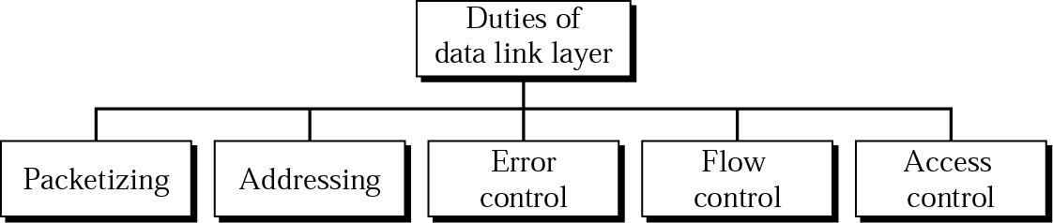
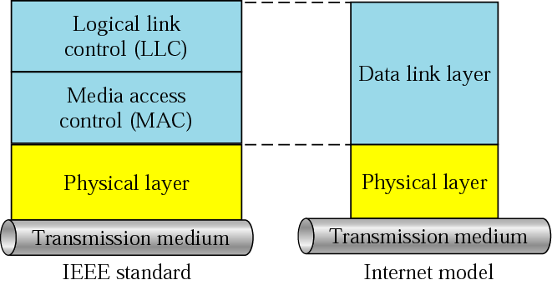
LLC and MAC sublayers

Slide 5
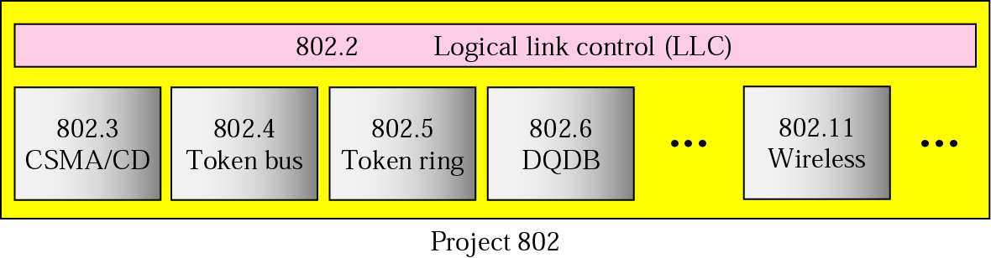
IEEE standards for LANs

Slide 6
Error Detection
and
Correction

Slide 7

Note:
Data can be corrupted during transmission. For reliable communication, errors must be detected and corrected.
Some applications can tolerate a small level of error. For example, random errors in audio or video transmissions may be tolerable,
but when we transfer text, we expect
a very high level of accuracy.

Slide 8
Types of Error
Single-Bit Error
Burst Error

Slide 9
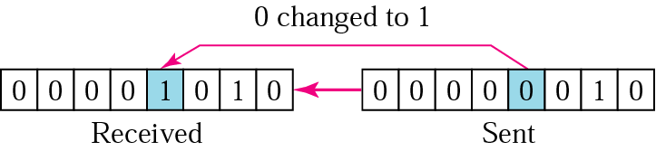
Note:
In a single-bit error, only one bit in the data unit has changed.

Slide 10
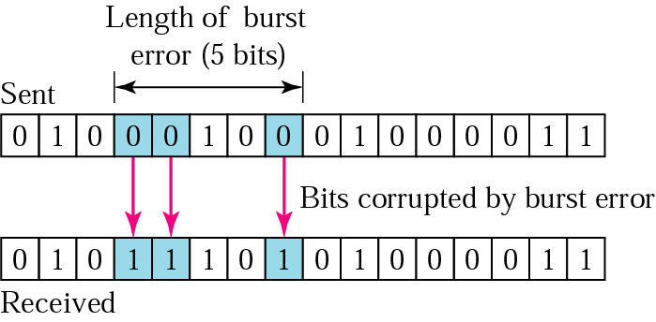
Note:
A burst error means that 2 or more bits in the data unit have changed.

Slide 11
Note:
Error detection uses the concept of redundancy, which means adding extra bits for detecting errors at the destination.

Slide 12
Detection
Redundancy
  Parity Check
  Cyclic Redundancy Check (CRC)
  Checksum

Slide 13
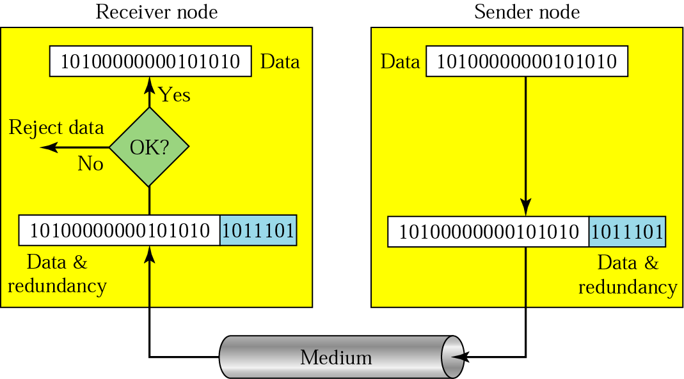
10.3 Redundancy

Slide 14
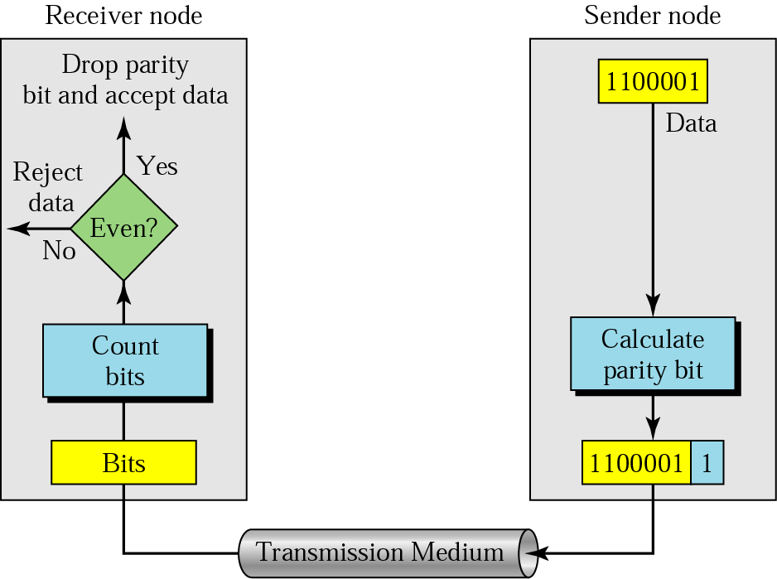
Even-parity concept
In parity check, a parity bit is added to every data unit so that the total number of 1s is even (or odd for odd-parity).

Slide 15
Example 1
Suppose the sender wants to send the word world. In ASCII the five characters are coded as
1110111 1101111 1110010 1101100 1100100
The following shows the actual bits sent
11101110 11011110 11100100 11011000 11001001

Slide 16
Example 2
Now suppose the word world in Example 1 is received by the receiver without being corrupted in transmission.
11101110 11011110 11100100 11011000 11001001

Slide 17
Example 3
Now suppose the word world in Example 1 is corrupted during transmission.
11111110 11011110 11101100 11011000 11001001
The receiver counts the 1s in each character and comes up with even and odd numbers (7, 6, 5, 4, 4). The receiver knows that the data are corrupted, discards them, and asks for retransmission.

Slide 18
Note:
Simple parity check can detect all single-bit errors. It can detect burst errors only if the total number of errors in each data
unit is odd.

Slide 19
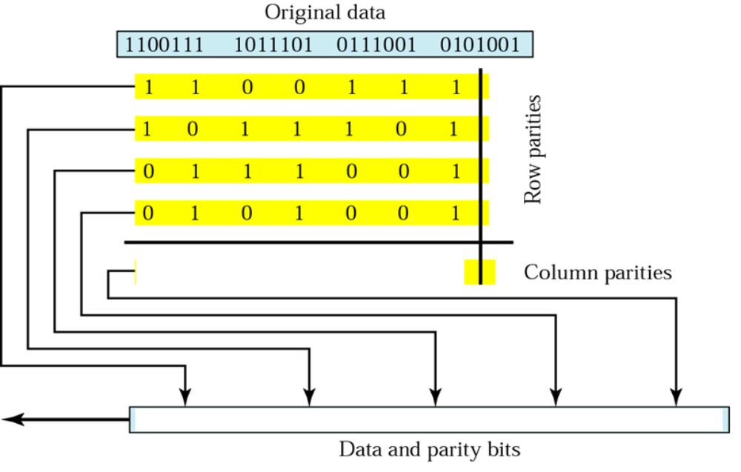
Two-dimensional parity

Slide 20
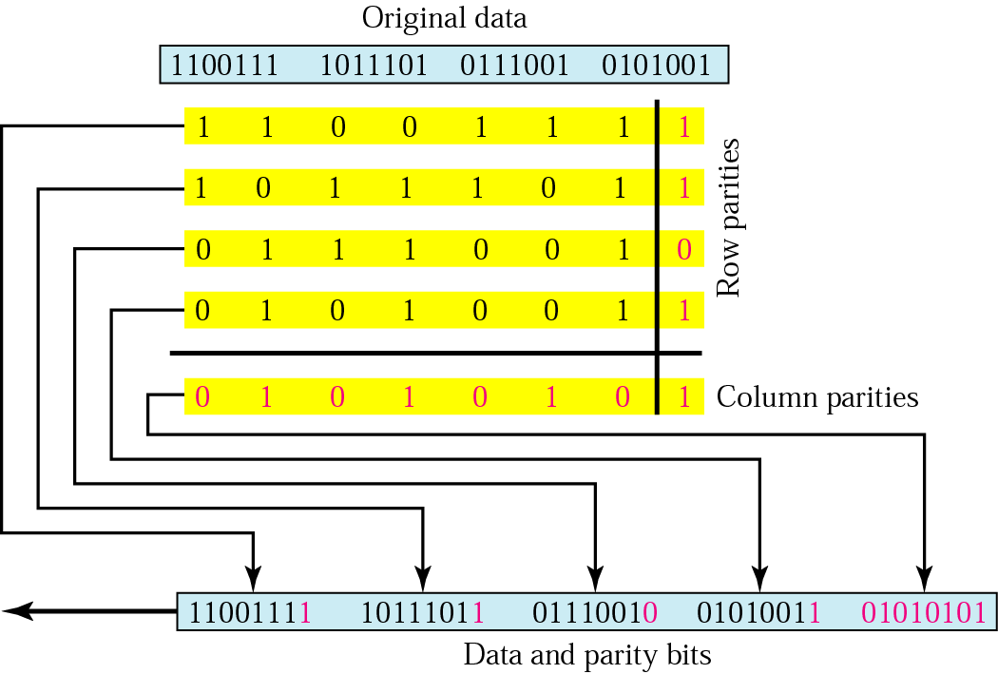
10.6 Two-dimensional parity

Slide 21
Example 4
Suppose the following block is sent:
10101001 00111001 11011101 11100111 10101010
However, it is hit by a burst noise of length 8, and some bits are corrupted.
10100011 10001001 11011101 11100111 10101010
When the receiver checks the parity bits, some of the bits do not follow the even-parity rule and the whole block is discarded.
10100011 10001001 11011101 11100111 10101010

Slide 22
Note:
In two-dimensional parity check, a block of bits is divided into rows and a redundant row of bits is added to the whole block.

Slide 23
Subjective Questions
How does a single-bit error differ from a burst error?
Discuss the concept of redundancy in error detection and correction.
How is the simple parity check related to the two-dimensional parity check?

Slide 24
Multiple Choice Questions
A burst error means that two or more bits in the data unit have changed.
a. double-bit
b. burst
c. single-bit
d. none of the above
A simple parity-check code can detect __________ errors.
a. an even-number of
b. two
c. no errors
d. an odd-number of

Slide 25
Multiple Choice Questions
A burst error means that two or more bits in the data unit have changed.
a. double-bit
b. burst
c. single-bit
d. none of the above
A simple parity-check code can detect __________ errors.
a. an even-number of
b. two
c. no errors
d. an odd-number of

Slide 26
References :
Text Book:
  Behrouz A. Forouzan, Data Communication and networking, 4th Ed., Tata McGraw Hills year of publication 2006
Other Specific Book:
  Andrew S. Tanenbaum,Computer Network 2nd Edition, PHI, Third Edition 1997
  Comer E. Doughlas,Computer Networks and Internets, 2nd Ed., Pearson, 2000
  W. Stallings,Data and Computer Communications, 7th Ed., Pearson, 2002.

Slide 27

See you in next class

